Slide 1


An Accelerator Architecture for Combinatorial Optimization Problems
From: FUJITSU SCIENTIFIC & TECHNICAL JOURNAL (FSTJ) 2017
Author: Sanroku Tsukamoto, Motomu Takatsu, Satoshi Matsubara , Hirotaka Tamura
Presenter: Ting-Yi Wu
Instructor: Jie-Hong Roland Jiang
ALCom Lab

Slide 2
Outline
Introduction
Operating principle
Benchmark results
Conclusion

Slide 3
INtroduction

Slide 4
Background
There are many situations in which difficult decisions must be made under such constraints as a limited resource and a limited amount of time.
e.g. disaster response planning, economic policy decision-making, and investment portfolio optimization
Combinatorial optimization problem
Difficult to find the best answer in a realistic amount of time using a von Neumann type processor

Slide 5
Background
Moore’s law will end within another decade. Something innovative computer architecture is needed.
Scaling-independent performance, power efficiency, and high speed
E.g. GPGPUs or FPGA
Quantum computers and coherent computers are expected to be applied to NP-hard problems, which are basically combinatorial optimization problems

Slide 6
Architecture
They propose an architecture for optimizing a fully connected 1024-bit Ising model implemented in an FPGA.
Solved a 32-city traveling salesman problem 12,000 times faster than a simulated annealing program running on a 3.5-GHz Intel Xeon E5-1620 v3 processor.
32-city TSP can be represented by a 32×32 matrix, in which the rows are the visiting order and the columns are the cities.
Need 1024 bits for a 32-city TSP

Slide 7
Ising model
Statistical model representing the spin
Atomic spins in two states(+1 or -1)
+1 : up
-1 : down

Slide 8
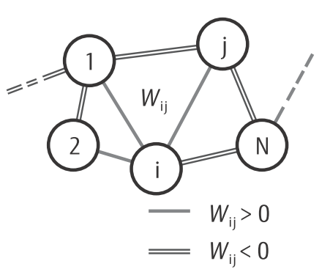
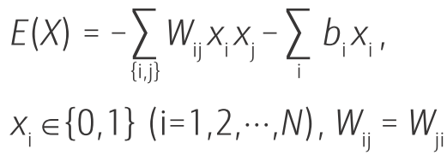
Ising energy
Markov-chain Monte Carlo (MCMC) stochastic search and thereby minimizes the Ising energy:
x_{i} ∈{0,1} is the state variable or bit
N : the number of bits
W_{ij} : the connection weight between x_{i} and x_{j}
b_{i} : the bias term

Slide 9
Operating principle

Slide 10
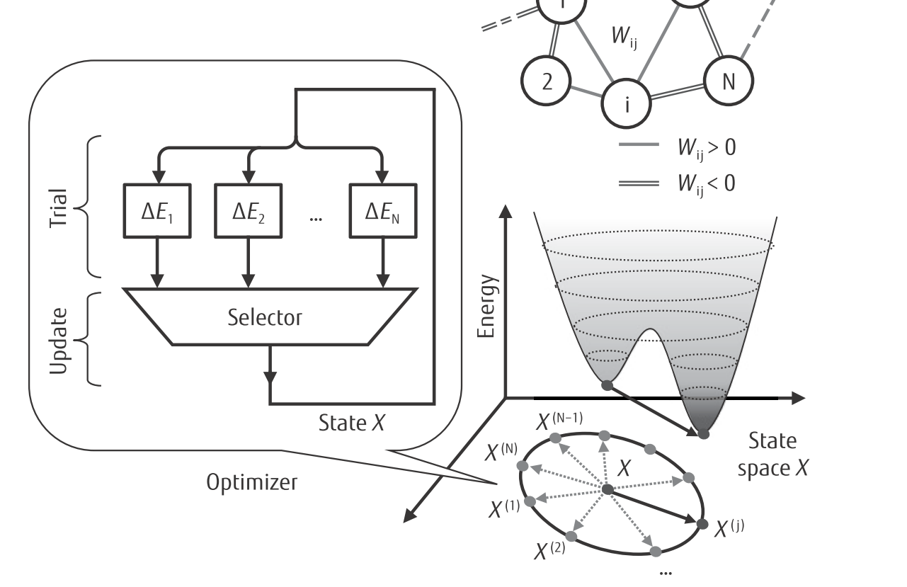
Operating steps
Two phases
Trial phase
state-variable change that meets an acceptance criterion is selected
Update phase
selected variable is flipped and relevant signals that depend on the variable are updated accordingly
Notes:
選擇滿足驗收標準的狀態變量更改

Slide 11

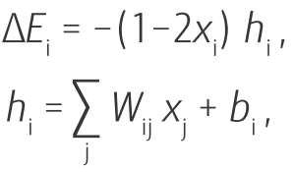
Trial phase
Each neuron i that generates state variable x_{i}, the increment in energy E when the state moves to a neighboring state X^{(i)} is calculated
Neighboring state X^{(i)} is generated from current state X=(x₁ , x₂ , ···, x_{N} ) by flipping state variable x_{i} to 1−x_{i} .

Slide 12
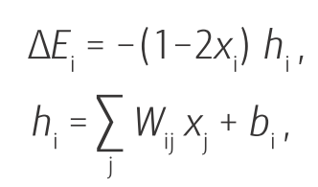
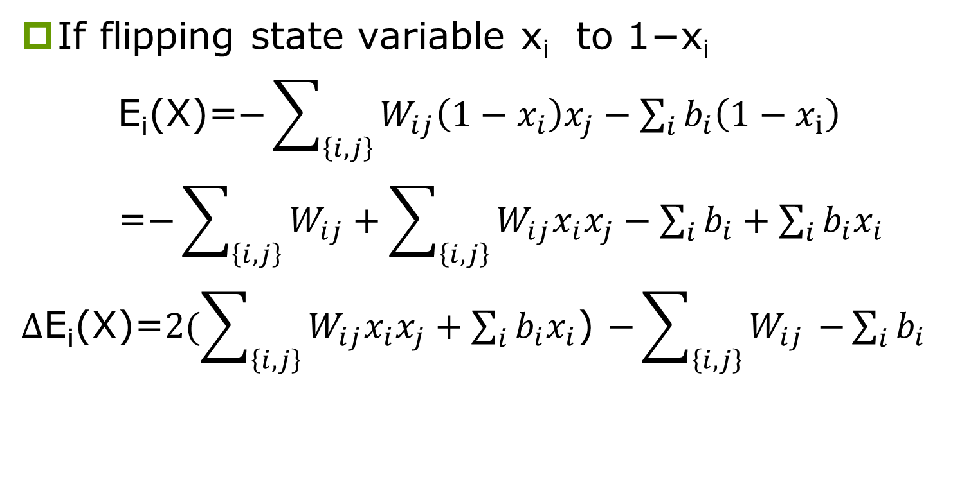

Trial phase
If flipping state variable x_{i} to 1−x_{i}
E_{i}(X)=$−\sum_{\left\{i,j\right\}}{W_{ij}\left(1−x_{i}\right)x_{j}}−\sum_{i}{b_{i}\left(1−x_{ⅈ}\right)}$
=$−\sum_{\left\{i,j\right\}}{W_{ij}}+\sum_{\left\{i,j\right\}}{W_{ij}x_{i}x_{j}}−\sum_{i}{b_{i}}+\sum_{i}{b_{i}x_{i}}$
$Δ$E_{i}(X)=$2(\sum_{\left\{i,j\right\}}{W_{ij}x_{i}x_{j}}+\sum_{i}{b_{i}x_{i}}$) $−\sum_{\left\{i,j\right\}}{W_{ij}}$ $−\sum_{i}{b_{i}}$
$Δ$E₁, $Δ$E₂, …, $Δ$E_{N} will trail at the same time_{i}

Slide 13
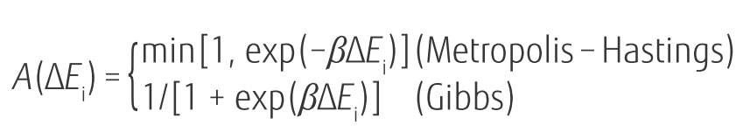

Trial phase
The criterion used in the trial phase is selectable from either Metropolis-Hastings or Gibbs ones:
is the acceptance probability of x_{i} flipping to 1−x_{i}

Slide 14
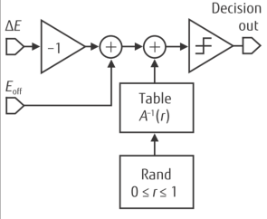
Acceptance Decision Block(ADB)
Each neuron compares the value of ΔE_{i} with a numerical noise value to produce a binary flag that becomes “1” with the probability given by
The numerical noise is generated by a table lookup from a random number r_{i} uniformly distributed between 0 and 1 so that the table outcome is A⁻¹ (r_{i})
The resulting flag bit indicates whether the corresponding state variable is a candidate.

Slide 15

Update phase
At most one state variable changes its value during the update phase, and local field values h_{i} (i=1,2,···,N) are stored in registers
When a state variable is updated, each local field is updated accordingly by adding its increment δh_{i} to its current value

Slide 16
Update phase: Acceleration scheme 1: parallel trials
The update selector selects a single state variable from the state variables having a flag value of “1.”
Generates a flag indicating whether there is a candidate bit or not and an index for the selected variable
Ten stages of two-to-one selectors perform the selection and the flag and index generation
If both inputs of the two-to-one selection stage are eligible for the next flip, one of them is randomly selected using a random binary number.

Slide 17
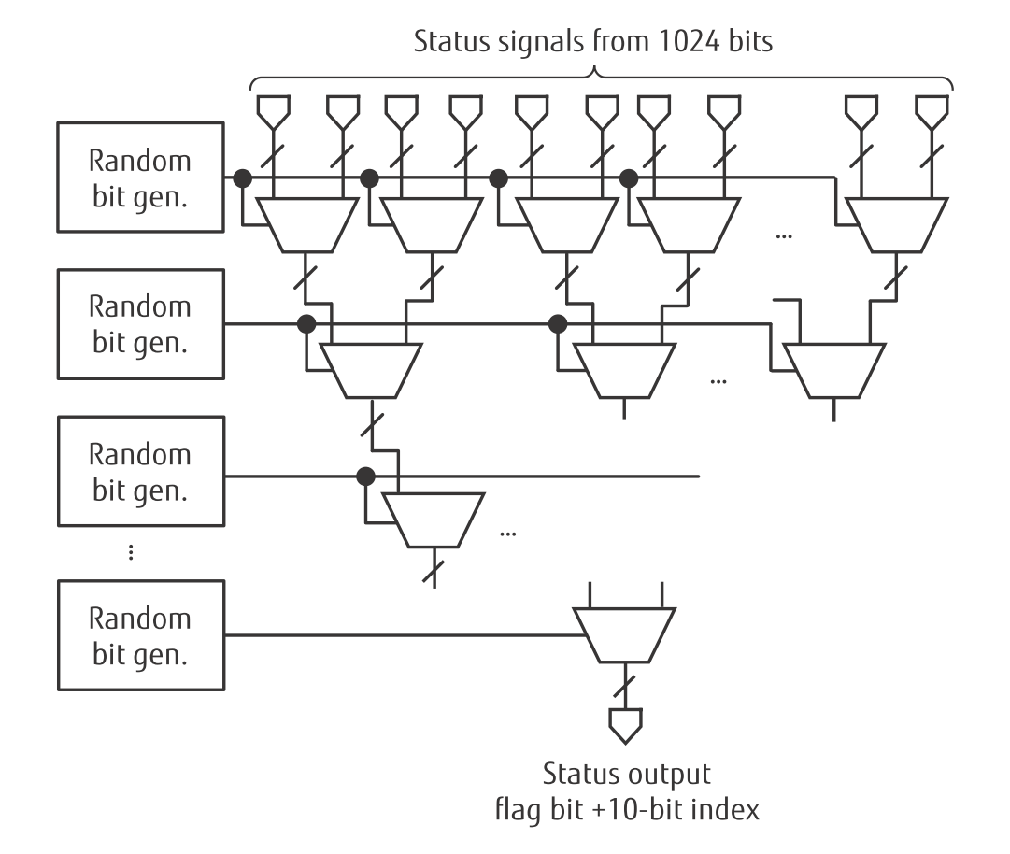
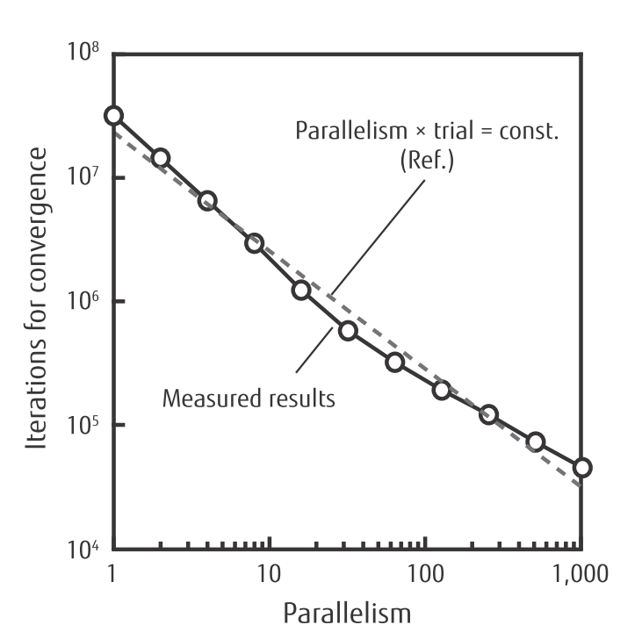
Update phase: Acceleration scheme 1: parallel trials
This parallel trial scheme accelerates convergence by increasing the probability of finding a state to which the system can move in the next update phase.
Number of cycles is inversely proportional to the parallelism of the trials

Slide 18
Acceleration scheme 2: dynamic offset
When the state is at a local minimum of the Ising energy function, the probability of moving to a new state is small.
Slows convergence
Rejection-free Metropolis scheme used by Zhu, et al., [9]
The probability of moving to another state is made equal to 1 by normalizing the state acceptance probability so that the sum of the normalized acceptance probabilities is 1, resulting in a time-warp feature whereby the number of cycles during which the system stays at a local minimum is reduced to one.

Slide 19

Acceleration scheme 2: dynamic offset
Although this time-warp feature is effective, the computational overhead for normalizing the acceptance probability is high.
To reduce the overhead while retaining the effects of the time-warp feature, we implemented a scheme to subtract a positive offset E _{off} from the energy increment which is approximately equivalent to multiplying a common constant factor by the state-flip acceptance probabilities.

Slide 20
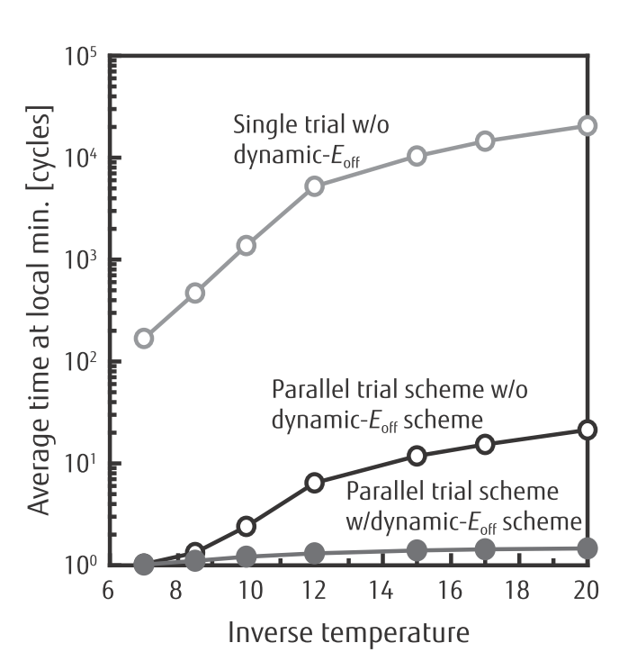
Acceleration scheme 2: dynamic offset
This scheme shortens the time the system spends at a local minimum

Slide 21
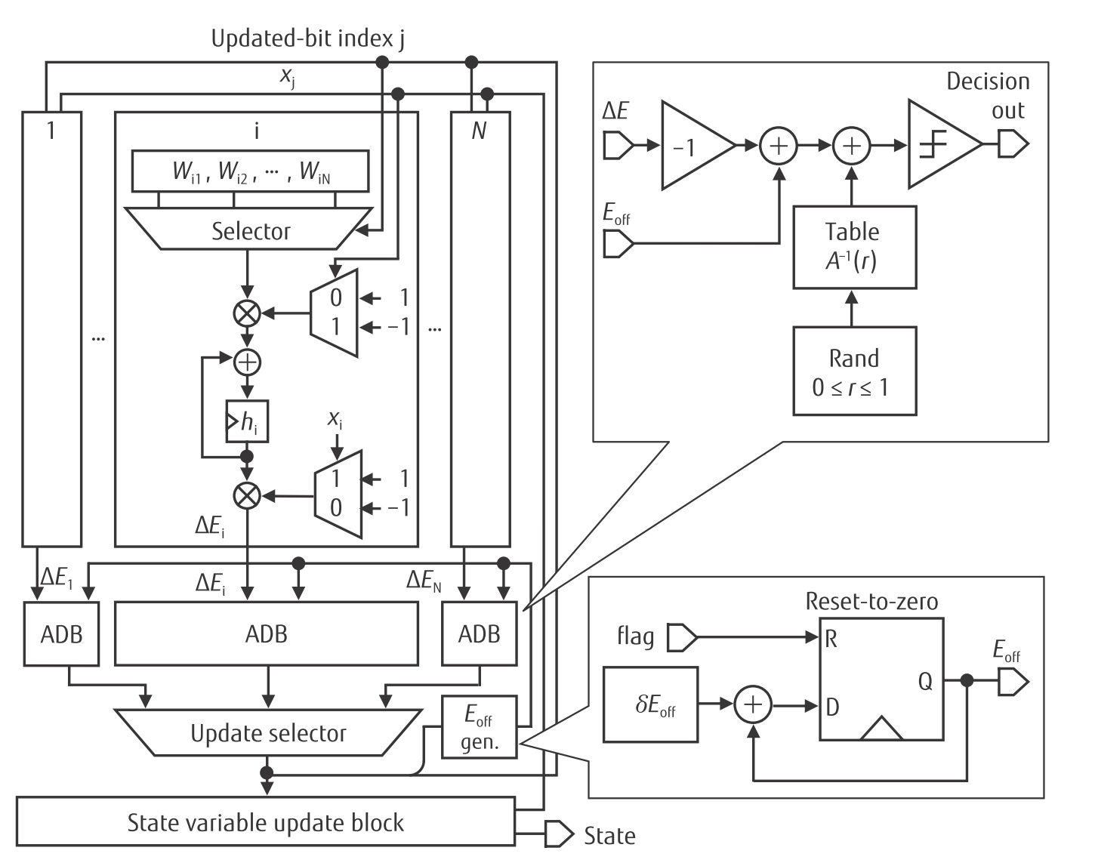
Optimizer architecture

Slide 22
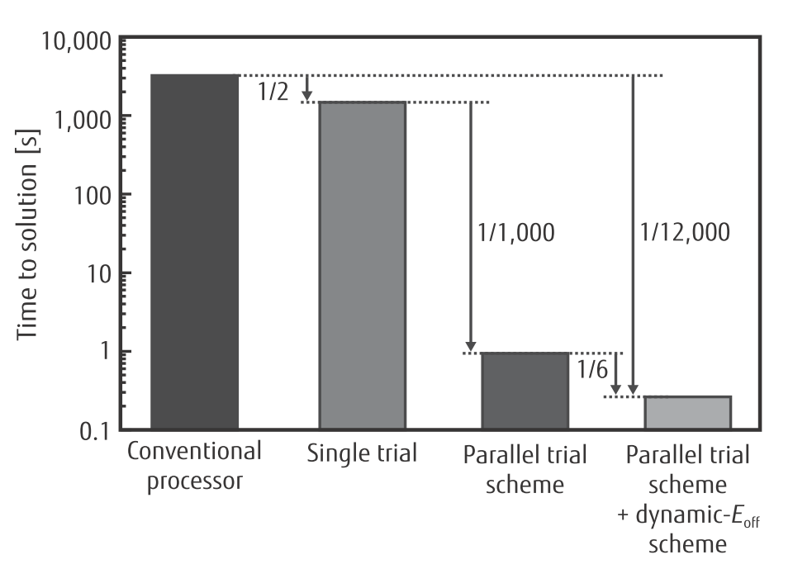
Benchmark results

Slide 23
Conclusion
Two schemes were developed for optimizing a fully connected 1024-bit Ising model and were implemented in an FPGA.
Testing demonstrated that a system using this architecture can solve the 32-city traveling salesman problem 12,000 times faster than one running on a conventional CPU using the same algorithm.

Slide 24
Reference
1) R. Colwell: The Chip Design Game at the End of Moore's Law. Hot Chips, Vol. 27, 2015.
2) J. G. Koomey et al.: IEEE Annals of the History of Computing, July–September, pp. 46–54, 2011.
3) M. Horowitz: Computing's Energy Problem: (and what we can do about it). ISSCC2014, 1-1, 2014 (referring to Markovic, EE292 Class, Stanford, 2013).
4) P. Bunyk et al.: Architectural Considerations in the Design of a Superconducting Quantum Annealing Processor. IEEE Trans. Applied Superconductivity, Vol. 24, No. 4, 2014.
5) S. Utsunomiya: Mapping of Ising models onto injection-locked laser systems. Optics Express, Vol. 19, No. 19, Sep. 2011.
6) P. A. Merolla et al.: A million spiking-neuron integrated circuit with a scalable communication network and interface. Science 8 August 2014, Vol. 345 No. 6197 pp. 668–673.
7) Y. Chen et al.: DaDianNao: A Machine-Learning Supercomputer. 47th IEEE/ACM Int. Symp. on Microarchitecture, pp. 609–622, 2014.
8) K. Hukushima and K. Nemoto: Exchange Monte Carlo Method and Application to Spin Glass Simulations. J. Phys. Soc. Jpn. Vol. 65, pp. 1604–1608, 1996.
9) H. Zhu et al.: A Boltzmann Machine with Non-rejective Move. IEICE Trans. Fundamentals of Electronics, Vol. E85-A, pp. 1229–1235, Jun. 2002.

Slide 25
THANK YOU

